Slide 1

Enhanced Vocabulary Trees for Real-Time Object Recognition in Image and Video Streams
Design Presentation
By Sugam Jaiswal, Josiah Zacharias, & Arsheya Raj
Notes:
EVERYONE

Slide 2
Contents
Project Overview >
Reference Paper >
Input Datasets >
K-means Tree Algorithm >
Feature Detection >
Project Scope /Application >
Data Structures >
Program Design >
Preliminary Results >
Future Work >
References >
Notes:
EVERYONE

Slide 3

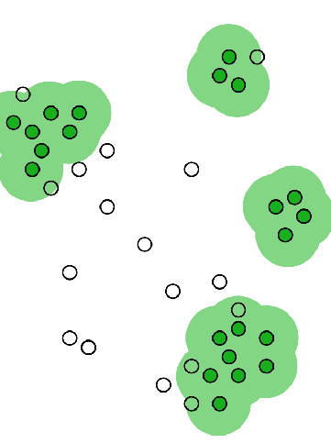
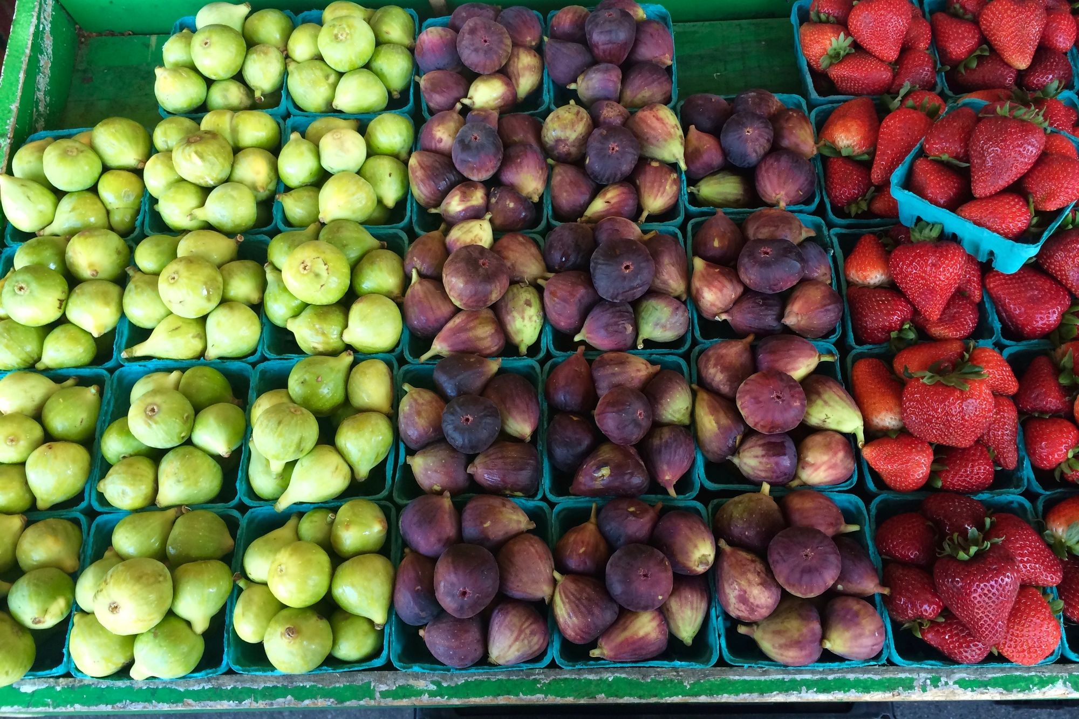
Project Overview
Goals:
Object Detection – Detect objects in large datasets of images and videos (e.g. COCO) – Achieve better performance than CNN (neural nets have poor performance on video frames)
Build Optimized Vocabulary Tree – Construct using hierarchical K-means clustering – Attempt other clustering algorithms and detector experimentation
Project as SaaS (hopeful) – Deploy to web application for service as business pitch – Only to be done once body of testing and performance is completed
Notes:
JOSIAH
Object Detection: We want to detect the objects for a large dataset of images and videos in the scale of millions. We would like to achieve a better performance than current state of the art object recognition techniques (like deep learning-based approaches) in terms of time and accuracy.
Build the Successful and optimized Vocabulary Tree: We will construct the Vocabulary tree using the hierarchical K-means clustering algorithm for our initial stage of the project. We can try different clustering algorithms too for constructing the tree.
Make our project as SaaS: We can construct a web application containing our project and we will deploy it on the web. This is our hopeful goal, to be done at the end once the body of testing and performance is completed.
We’ll be comparing the accuracy and time of the proposed recognition system with the current state-of-the-art object recognition techniques. The level of consistency in the results across different datasets will also be one of the evaluation criterias of our project, including quantitative evaluation against benchmark datasets, including PASCAL or Microsoft COCO.
Additionally, we will assess the practicality of our approach in real-time applications, such as autonomous vehicles or …, which will involve qualitative evaluations by testing our system on video streams, simulating these scenarios, and gathering feedback.

Slide 4
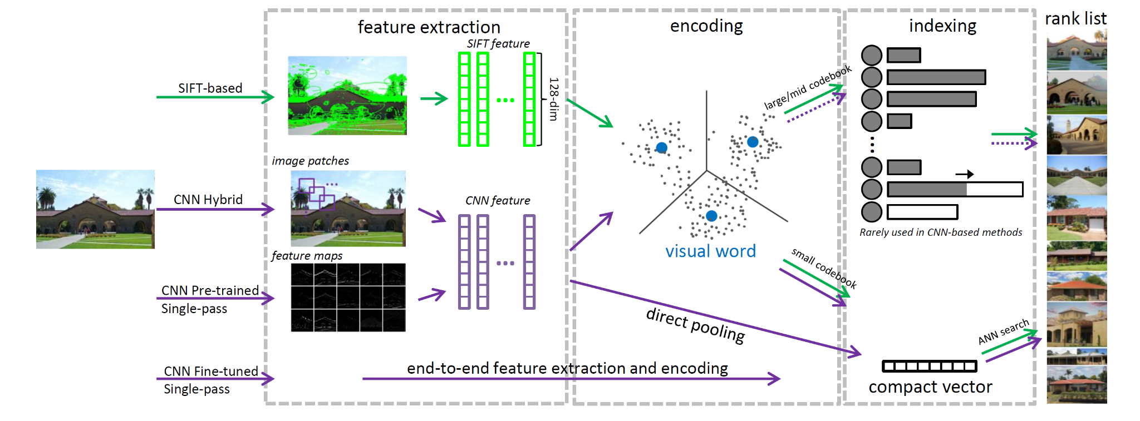
Reference Paper
Nister, D., & Stewenius, H. (2006). Scalable Recognition with a Vocabulary Tree. In 2006 IEEE Computer Society Conference on Computer Vision and Pattern Recognition (CVPR'06) (Vol. 2, pp. 2161-2168). IEEE.
https://inst.eecs.berkeley.edu//~cs294-6/fa06/papers/nister_stewenius_cvpr2006.pdf
Notes:
ARSHEYA
The paper which we chose is called ‘Scalable Recognition with a Vocabulary Tree’.
The paper is aimed at solving the problem of scalable object recognition by proposing a scheme to identify and label the objects in images from a large set of labels.
Object recognition is one of the most fundamental problems in the domain of computer vision and it has its own challenges like complexity and variability in images.
Additionally, an extremely large number of objects to be recognized severely degrades performance of object recognition methods and requires large-scale object recognition techniques.
The paper solves this problem by proposing a novel approach for object recognition to handle many objects accurately, like a bag-of-words(features).
To do so, the paper presents a hierarchical vocabulary tree constructed by recursively applying k-means clustering on a large set of features to index and match the local features of an image.
The paper also uses an inverted file system that stores the image IDs and feature weights for each leaf node allowing fast retrieval of relevant images.

Slide 5

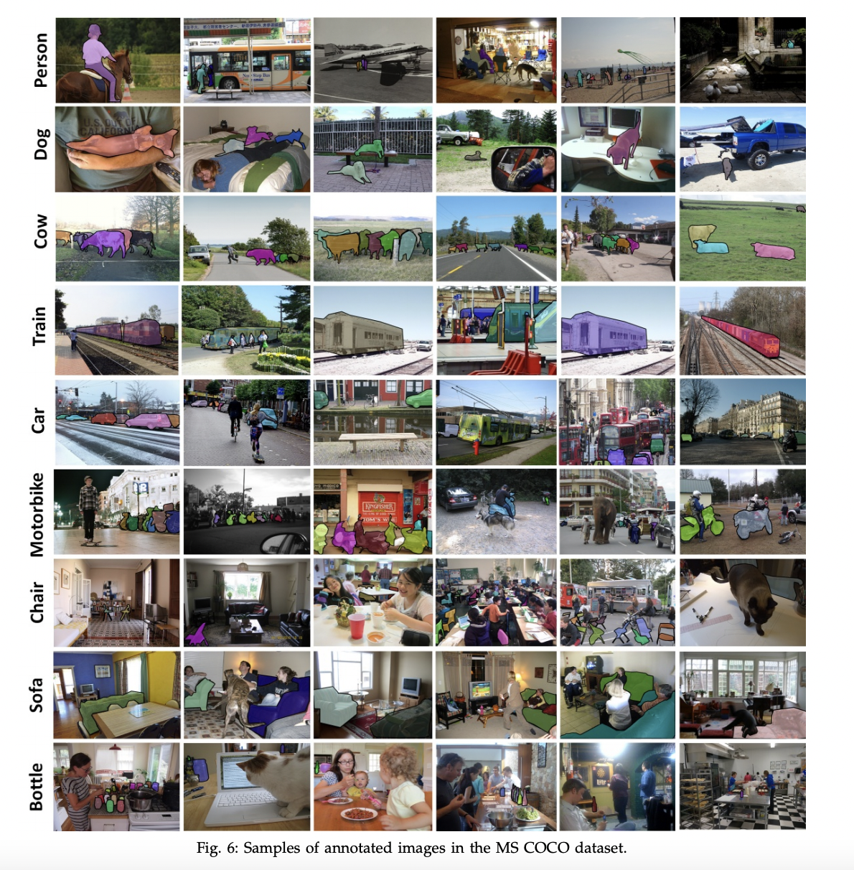

Input Datasets
5
Notes:
SUGAM
The input can be an image/video from a huge dataset of images and video/video streams. Some of the input datasets we might use will Microsoft COCO, and also possibly ImageNet and BDD100K(UC Berkeley”Deep Drive”).
Microsoft COCO (Common Objects in Context) is a large-scale dataset designed for various computer vision tasks, such as object detection, segmentation, and captioning.
COCO contains over 200,000 labeled images with more than 1.5 million object instances across 80 object categories
Provides rich annotations, including object bounding boxes, segmentation masks, and captions—ideal for training and evaluation
Images in COCO encompass a wide range of scenes, settings, and lighting conditions—helps testing robustness and extensibility of computer vision models
Currently, the COCO dataset comprises 330K images annotated with 80 different object categories. There are different versions of the dataset publicly available for testing various CV tasks like segmentation, captioning, object recognition, etc. However, it's not easy to download hence downloaded the annotations in JSON format which has respective image URLs and then parsed them using PyCocoTools Python library to download the images

Slide 6
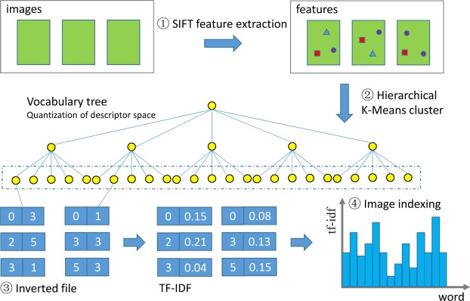
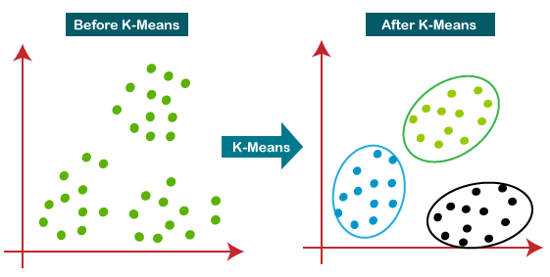
K-Means Tree Algorithm
https://www.sciencedirect.com/science/article/abs/pii/S0924271622000727
Notes:
ARSHEYA + SUGAM
K-means clustering is an unsupervised machine learning algorithm that groups similar data points together based on their features. The algorithm partitions the dataset into K clusters, each with a centroid (center point) that represents the mean of the cluster members. The objective is to minimize the distance between each data point and its respective centroid.
The main idea behind this approach is to represent images by local descriptors (e.g., SIFT) and then cluster these descriptors into a hierarchical structure known as a vocabulary tree.
Overview:
Extract local descriptors from a set of training images. These descriptors capture important visual features, such as corners and edges, which are used to describe the content of the images.
Use hierarchical K-means clustering to build the vocabulary tree. Initially, K-means clustering is applied to the descriptors to create a set of K centroids. Then, for each centroid, K-means is recursively applied to the descriptors belonging to that centroid until a desired depth is reached. Each node in the tree represents a visual word, while the centroids at the leaf nodes represent the finest partitioning of the descriptor space.
Assign each descriptor to the nearest leaf node (visual word) in the vocabulary tree, effectively quantizing the descriptor space.
Represent each image as a histogram of visual words. By counting the frequency of each visual word in an image, a compact and discriminative representation is created, which can be efficiently compared to other images using distance metrics, such as Euclidean or cosine distance.
The vocabulary tree enables efficient and scalable image recognition by reducing the search space and enabling fast image matching.

Slide 7
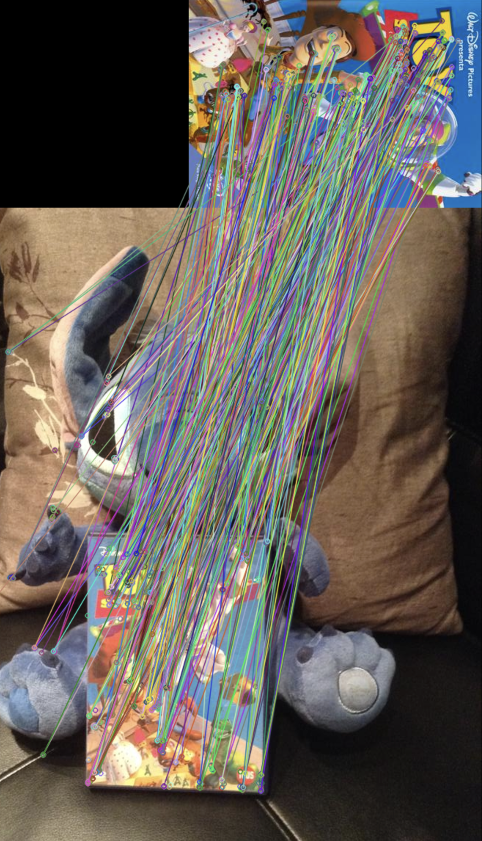
Feature Detectors
Considerations:
Sift – Basis of original paper's approach – Robust to scaling, rotation, and changes in lighting
SURF (Speeded-Up Robust Features) – Improved version of SIFT—faster and more efficient
ORB (Oriented FAST and Rotated BRIEF) – Fast, invariant to rotation and robust to noise. – Combines FAST keypoint detector and BRIEF descriptor and is more computationally efficient than SIFT or SURF.
Notes:
JOSIAH We will explore alternative feature detectors like SIFT, SURF, ORB, and others, as well as various tree construction techniques to build a Vocabulary decision tree using the descriptors and K-means clustering to optimize performance in real-time object recognition in image and video streams and real-world applications.

Slide 8
Project Scope / Application
Project scope :
Vocabulary Tree – Address challenges of large-scale visual recognition tasks using a vocabulary tree approach
Improved algorithms – Feature detection/extraction, image representation, indexing, and efficient search techniques within a hierarchical structure
Large visual datasets – Enhance recognition performance and scalability in handling large-scale visual datasets
Potential Applications:
Object recognition – Identify /classify objects in images /videos, for automated image tagging, object detection, and visual search
Image retrieval –Applications like efficient content-based image retrieval and plagiarism detection from large databases
Scene recognition –Automated analysis and categorization of images based on their contextual information
Visual surveillance – Activities such as object / person tracking, anomaly detection, and event recognition
Augmented reality – Overlay of virtual objects onto the real-world environment in augmented reality applications
Medical imaging – Medical image analysis, assisting in tasks like tumor detection, organ segmentation, and disease classification
Notes:
JOSIAH + JUMP ONE
The output will be the recognized objects in the images or video annotated by bounding boxes indicating the type and location of the detected objects.

Slide 9
Data Structures
OpenCV available structures
TermCriteria
Kmeans() function
FeatureDetector — ORB
Non-OpenCV (Trees)
Tree implemented via Vector<Mat> in database
Images from python Library called pycocotools.COCO dataset
Current sample 10 images, implemented with Python
Test data and Testing methodology
The test data contains 10 images of planes and these planes are divided in the clusters. Another test contained 10 images from planes, people and clock divided into 3 clusters
Score calculation in testing data
Linear algebra-based score calculation normalization
Notes:
SUGAM
Kmeans() function
Input parameters
samples : It should be of np.float32 data type, and each feature should be put in a single column.
nclusters(K) : Number of clusters required at end
criteria : It is the iteration termination criteria. When this criteria is satisfied, algorithm iteration stops. Actually, it should be a tuple of 3 parameters. They are `( type, max_iter, epsilon )`:
type of termination criteria. It has 3 flags as below:
cv.TERM_CRITERIA_EPS - stop the algorithm iteration if specified accuracy, epsilon, is reached.
cv.TERM_CRITERIA_MAX_ITER - stop the algorithm after the specified number of iterations, max_iter.
cv.TERM_CRITERIA_EPS + cv.TERM_CRITERIA_MAX_ITER - stop the iteration when any of the above condition is met.
max_iter - An integer specifying maximum number of iterations.
epsilon - Required accuracy
attempts : Flag to specify the number of times the algorithm is executed using different initial labellings. The algorithm returns the labels that yield the best compactness. This compactness is returned as output.
flags : This flag is used to specify how initial centers are taken. Normally two flags are used for this : cv.KMEANS_PP_CENTERS and cv.KMEANS_RANDOM_CENTERS.
Output parameters
compactness : It is the sum of squared distance from each point to their corresponding centers.
labels : This is the label array (same as 'code' in previous article) where each element marked '0', '1'.....
centers : This is array of centers of clusters.
Now we will see how to apply K-Means algorithm with three examples.

Slide 10
Program Design
Input dataset installation
ORB detector
K-means clustering
Agglomerative clustering
Max Voting
Cluster Reassignment
Database construction and indexing
Score Calculation
K=3 for k-means and we are running 50 iterations for the convergence. EPS value is 1.0 for the eigen values distance calculation.
Orb feature
Notes:
ARSHEYA
Input dataset installation
ORB detector
K-means clustering
Agglomerative clustering
Max Voting
Cluster Reassignment
Database construction and indexing
Score Calculation

Slide 11
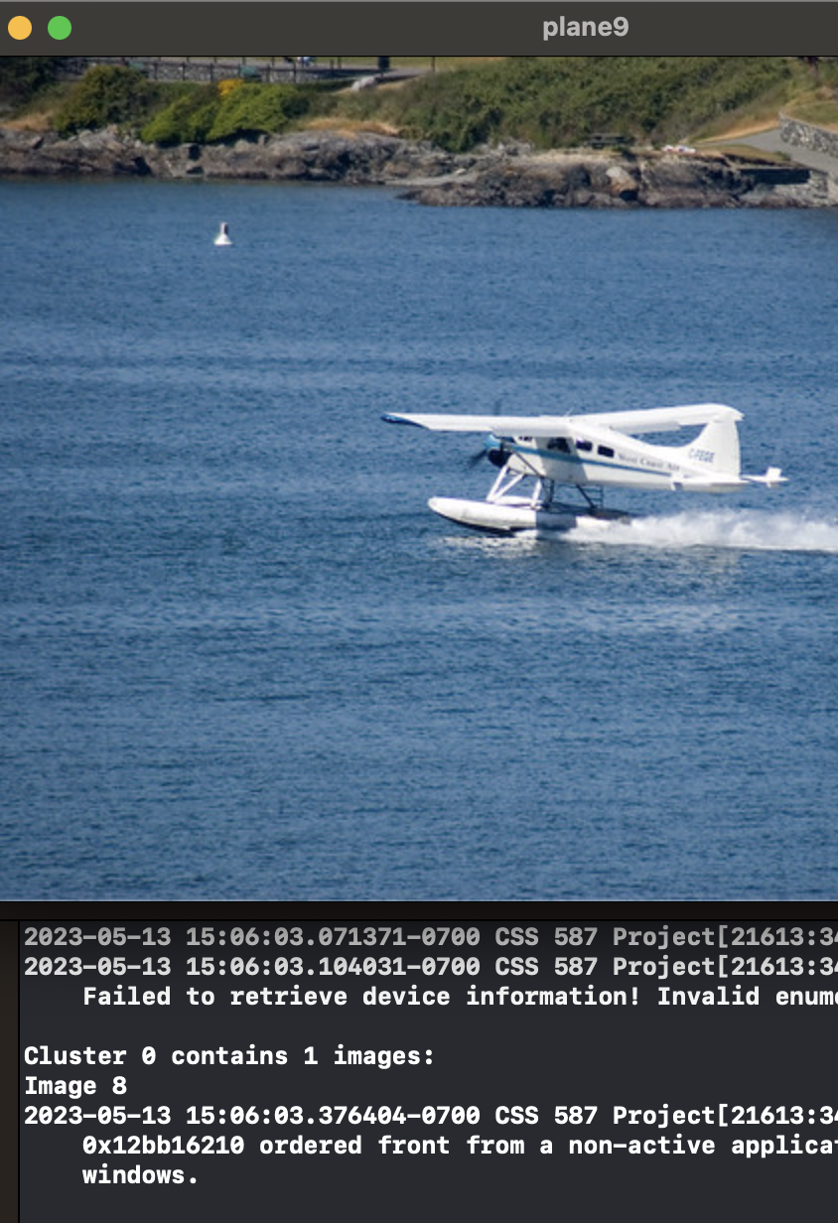
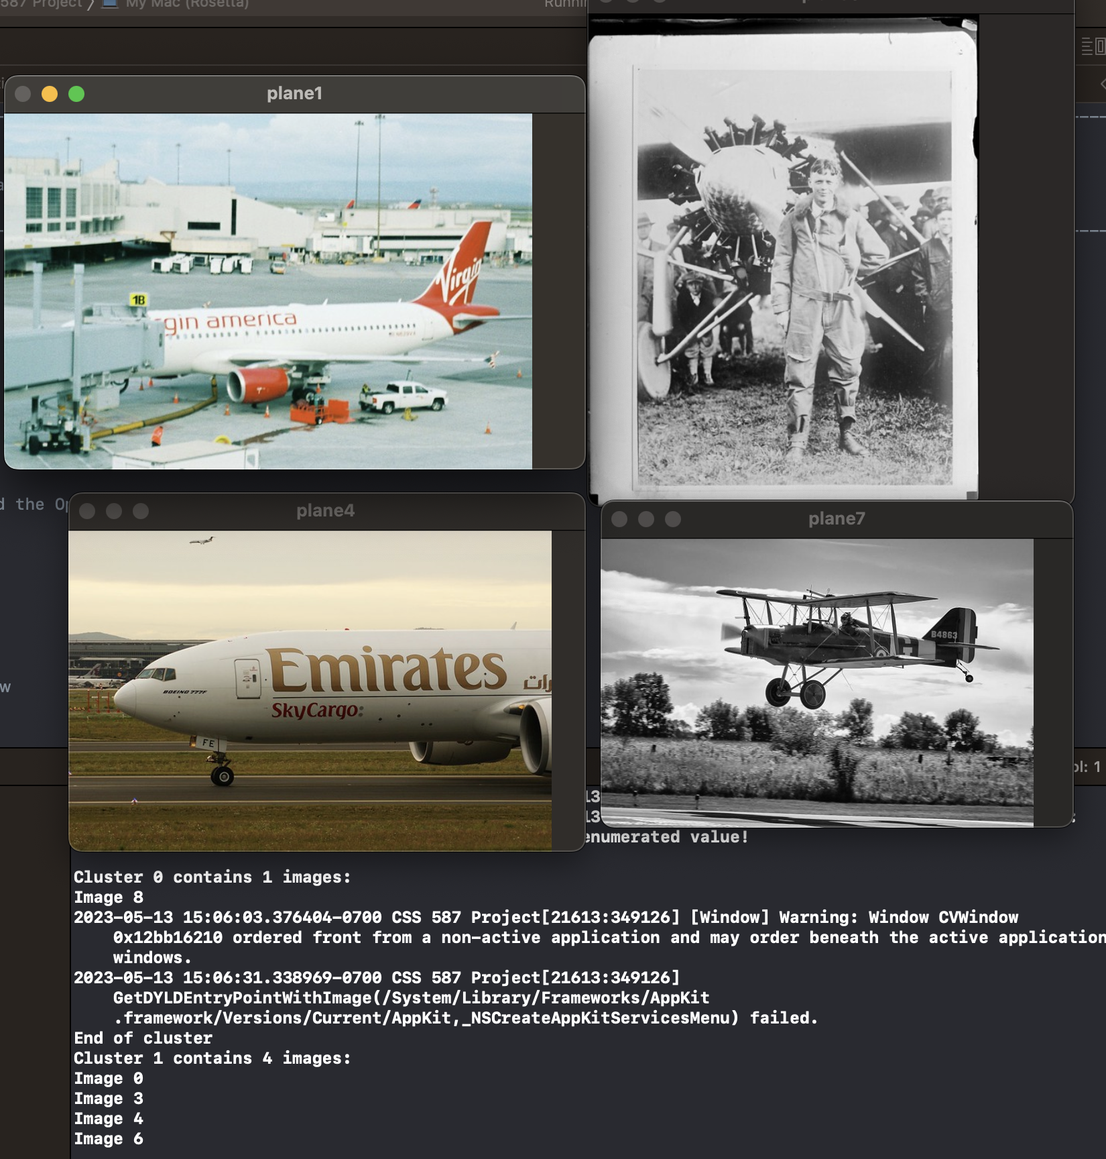
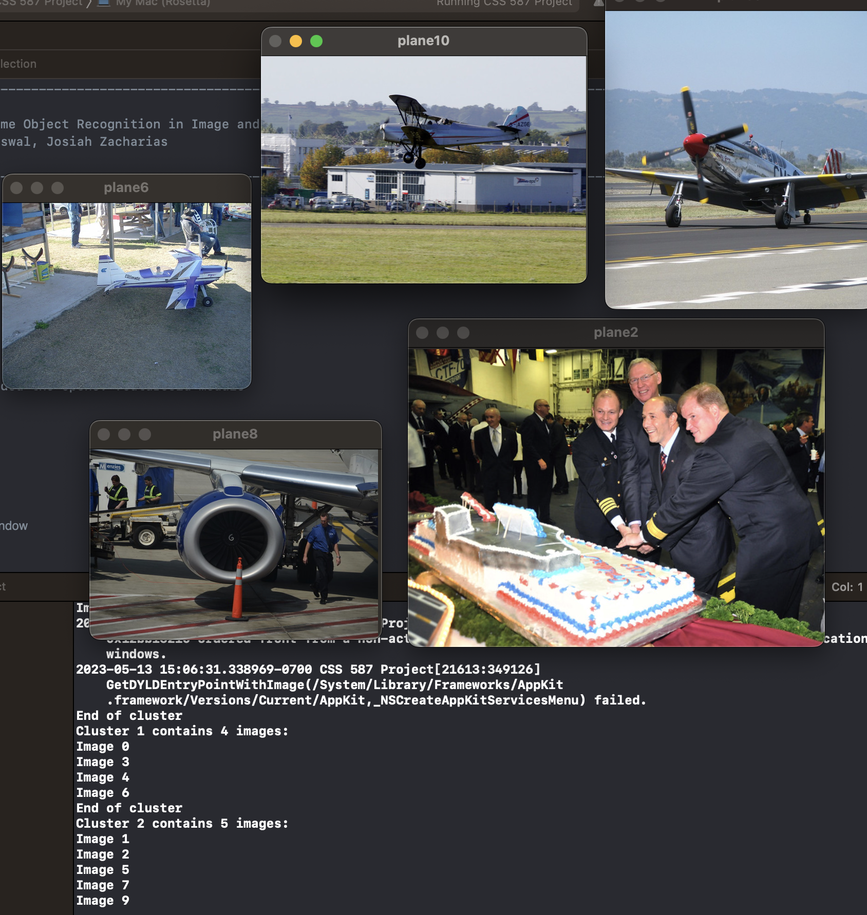
Preliminary Results
Notes:
SUGAM
1st Test: 10 images from the same object category (plane) grouped into 3 clusters using the K-means function previously discussed. The second cluster makes sense as the shape kind of match and the color grading is similar. The first image of the 3rd cluster should have been grouped together with the first cluster but that's the kind accuracy compromise we might have to adjust for while choosing ORB over SIFT and others.

Slide 12
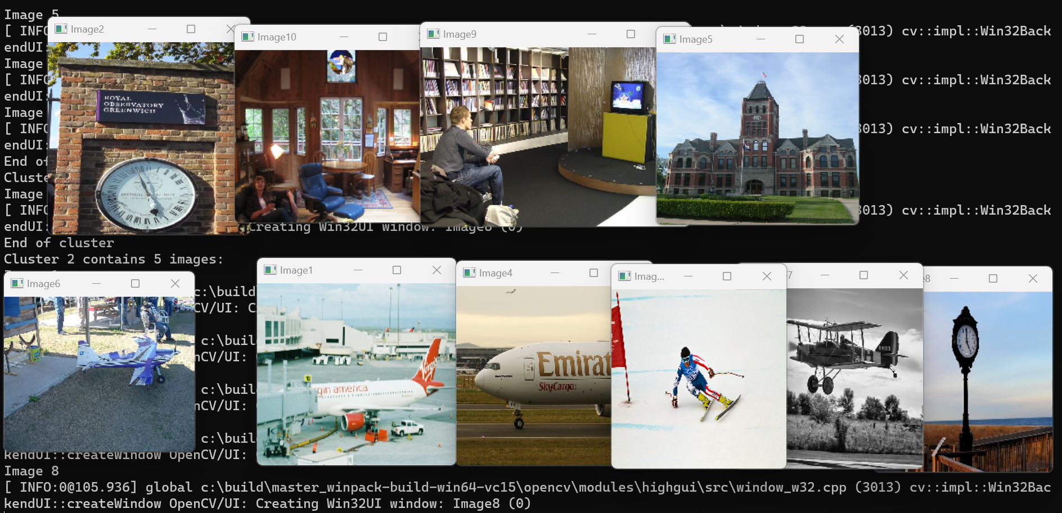
Preliminary Results
Notes:
SUGAM, ARSHEYA Commentary
2nd test: 10 test images from 3 different object categories (people, plane and clock) divided into 3 clusters using the same parameters as before. It doesn't form significant clusters. The ideal clusters should have grouped the images in each category together but the results are highly influenced by the other objects in the images.

Slide 13
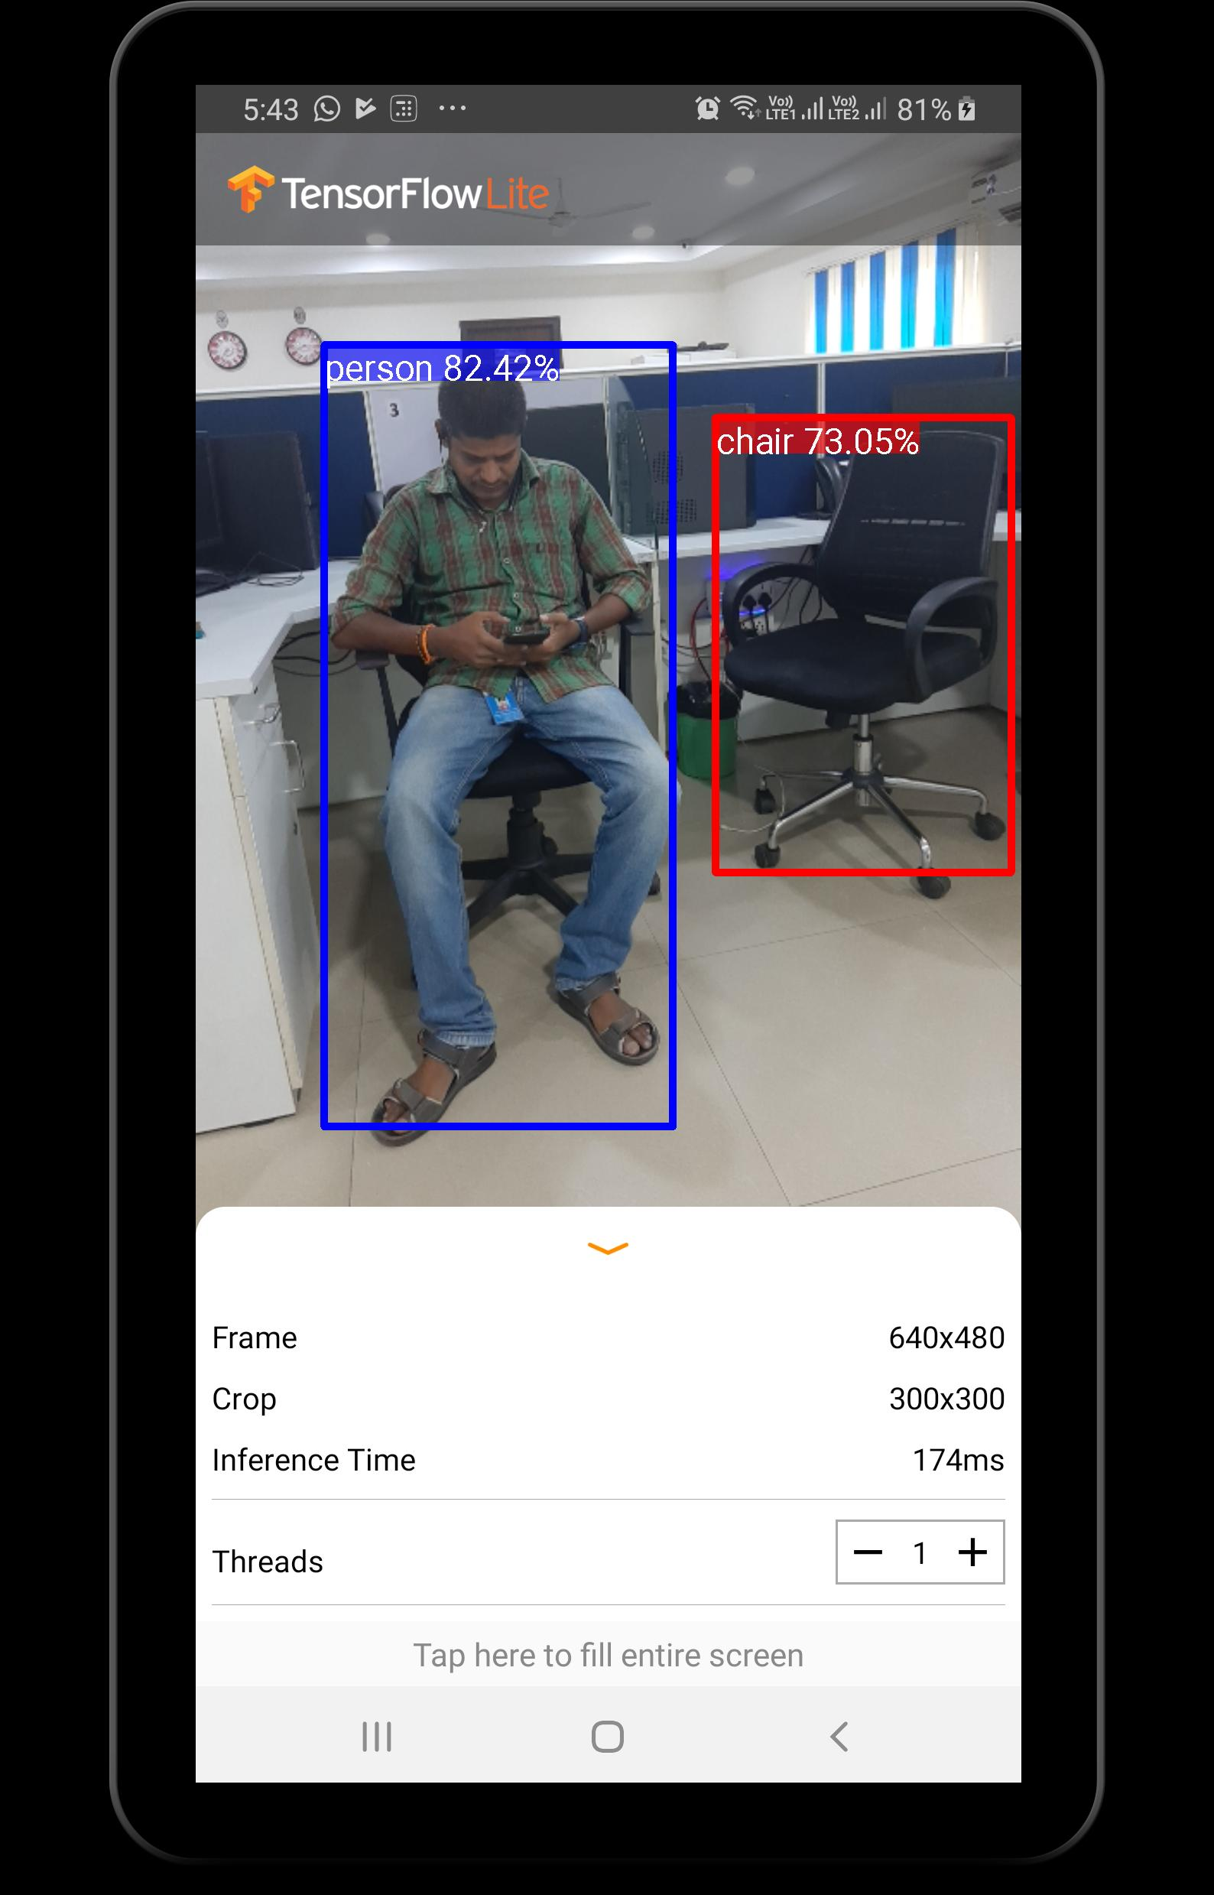
Future Work
Try with the bigger dataset of COCO
Try different Feature Detectors
Try different clustering algorithms (agglomerative clustering)
Reduce Noise and get a good score
Compare results with research paper
SaaS implementation and User Interface
Vocab Tree Detector
Notes:
ALL

Slide 14
References
Nister, D., & Stewenius, H. (2006). Scalable Recognition with a Vocabulary Tree. In 2006 IEEE Computer Society Conference on Computer Vision and Pattern Recognition (CVPR'06) (Vol. 2, pp. 2161-2168). IEEE.
https://inst.eecs.berkeley.edu//~cs294-6/fa06/papers/nister_stewenius_cvpr2006.pdf
We will use the OpenCV library for implementing the vocabulary tree and object recognition system.
Additionally, we plan to utilize the code and ideas provided in the GitHub repository “Scalable Recognition with a Vocabulary Tree” as a starting point.
Fifty One integrations: The open-source tool for building high-quality datasets and computer vision models.
https://docs.voxel51.com/
Notes:
ARSHEYA
Nister, D., & Stewenius, H. (2006). Scalable Recognition with a Vocabulary Tree. In 2006 IEEE Computer Society Conference on Computer Vision and Pattern Recognition (CVPR'06) (Vol. 2, pp. 2161-2168). IEEE.
https://inst.eecs.berkeley.edu//~cs294-6/fa06/papers/nister_stewenius_cvpr2006.pdf
We will use the OpenCV library for implementing the vocabulary tree and object recognition system. Additionally, we plan to utilize the code and ideas provided in the GitHub repository “Scalable Recognition with a Vocabulary Tree” as a starting point.

